Slide 1
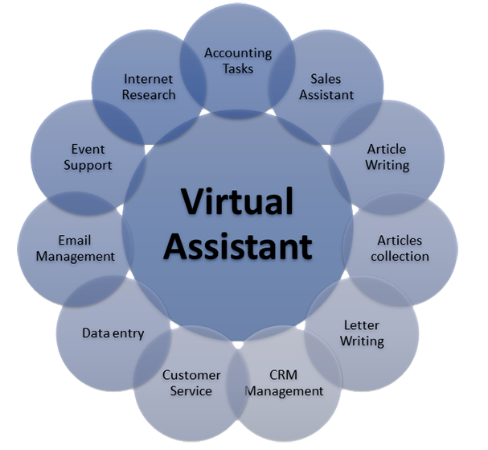
VIRTUAL ASSISTANT

Slide 2
By: GUDIBANDI SAI MAHITHA (20891A0520) POTTABATTHINI JHANSI (20891A0546) VENKATA SAI SOWMYA GURRALA (20891A0559) GUIDED By: MR. R. MAHESH ASSISTANT PROFFESSOR

Slide 3
ABSTRACT:
A virtual assistant is also called as AI assistant or digital assistant.IT is an application program that understand natural language voice commands and completes tasks for user.Virtual assistant typically performs simple jobs for end users such as providing information,opening applications,palying music etc..

Slide 4
INTRODUCTION
A virtual assistant is a self-employed independent contractor who provides administrative or technical services to a client while working remotely, outside the client's place of business. They typically assist with tasks that take up considerable time for their client, such as scheduling meetings and appointments. Virtual assistants usually work from home but have access to the digital resources necessary to do their job. For example, they may be able to enter data into a client's database and add appointments on their digital calendars.

Slide 5
Requirements for project
Software requirements:
Windows 10 pro
Python IDLE (3.10.1)
Hardware requirements:8GB RAM

Slide 6

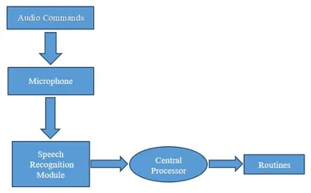
BLOCK DIAGRAM

Slide 7
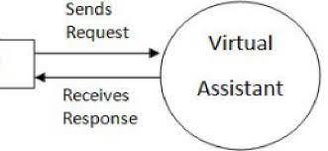
Superior organizational skills: VAs have to be organized to keep track of assignments for different clients.
Communication skills: Since they work remotely, VAs have to be adept at communicating by email and phone.
Tech savvy: The best VAs have a wide range of computer skills and are proficient at the most commonly used software programs.
Multitasking: VAs need to be comfortable jumping from one task to another as individual clients make new request.
Qualities of VA:

Slide 8
Speech recognition:Speech recognition is used to identify words in spoken language. Voice recognition is a biometric technology for identifying an individual's voice.
Pyttsx3:pyttsx3 is a text-to-speech conversion library in Python
runAndWait(): This function will make the speech audible in the system, if you don't write this command then the speech will not be audible to you.
Wikipedia:Wikipedia is a Python library that makes it easy to access and parse data from Wikipedia. Search Wikipedia, get article summaries, get data like links and images from a page, and more.
Webbrowser:The webbrowser module provides a high-level interface to allow displaying web-based documents to users.

Slide 9
Pywhatkit:It uses the WhatsApp web to send these messages.
OS module:The OS module in Python provides functions for interacting with the operating system. OS comes under Python's standard utility modules. This module provides a portable way of using operating system-dependent functionality.
Subprocess:The subprocess module present in Python it is used to run new applications or programs through Python code by creating new processes. It also helps to obtain the input/output/error pipes as well as the exit codes of various commands.
DateAndTime:Python Datetime module supplies classes to work with date and time. These classes provide a number of functions to deal with dates, times and time intervals. Date and datetime are an object in Python, so when you manipulate them, you are actually manipulating objects and not string or timestamps

Slide 10
Thank you

